Slide 1






PRESENTATION 2026
Smart banking customer financial health and risk analysis Dashboard
Mentor Name
Student Name
Student Email
Uma Maheshwari
K .Bhavya
bhavyakandula40@gmail.com

Slide 2

Outline
Abstract of the Project
Problem Statement
Proposed Solution
System Architecture
Live Demo of the Project
Embedded Video of Project
Conclusion
Future Scope

Slide 3
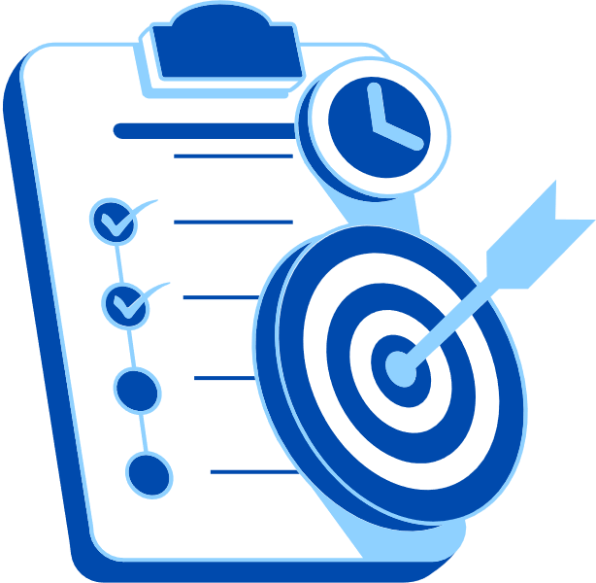
Abstract
Analyze banking customer data to understand financial behavior, spending patterns, and risk levels.
Objective is to convert raw data into meaningful insights for better decision-making.
Uses Microsoft Excel for data cleaning and preprocessing.
Uses Power BI to create interactive dashboards and visualizations.
Integrates AI tools like Chat GPT/Copilot for insights and report generation.
Identifies high-value customers and detects potential financial risks.
Provides clear, data-driven insights through dashboards.
Key highlight: Combines AI with business intelligence tools for smarter and more efficient analysis.

Slide 4

Problem Statement
Banks collect large volumes of customer financial data daily, but this data is often not properly utilized to assess financial health and risk levels. Due to lack of structured analysis and visualization, it becomes difficult to identify high-risk customers and support effective decision-making.
At the same time, AI tools like Microsoft Copilot and chatbots offer opportunities to enhance data analysis, but many users lack the skills to use them effectively.
• Background of the banking domain and challenges in analyzing customer financial data. • Importance of identifying financial health and risk levels in real-world banking. • Gap in effectively utilizing data and AI tools for decision-making. • Value delivered to banks in improving risk assessment and customer analysis.
• Need for real-time monitoring of customer transactions and financial activities. • Challenges in identifying early warning signs of financial instability. • Lack of integrated systems for combining multiple financial indicators

Slide 5

Proposed Solution
The proposed solution focuses on transforming raw banking data into meaningful insights to improve decision-making and customer analysis. Microsoft Excel is used for data cleaning and preprocessing, while Power BI is used to create interactive dashboards for visualizing customer behavior and financial performance. AI tools like Copilot are integrated to generate insights and automate reporting. The approach follows a structured process of data collection, cleaning, analysis, and visualization, helping to identify customer segments and risk levels more efficiently compared to traditional methods.

Slide 6
System Architecture
Data Input / Source
Processing / Analysis
Real includes key details like demographics, account types, balances, income, and credit score.
Acts as the primary input for financial analysis and insights generation.
Data is directly uploaded into Excel and Power BI for processing.
No external APIs or databases used, ensuring a simple and controlled data environment.
l-world inspired banking customer dataset in Excel format.
Raw data is refined in Excel by removing duplicates and fixing missing values.
Data is standardized and structured to ensure accuracy and consistency.
Data is organized using sorting, filtering, and conditional formatting techniques.
Advanced calculations and aggregations are applied to uncover hidden patterns.
Power BI transforms the processed data into interactive visuals and meaningful insights.
AI / Tool Integration
Output / Dashboard
Excel is used for data cleaning, preprocessing, and basic analysis.
Power BI is connected to Excel data to build interactive dashboards and visualizations.
AI tools like Copilot are used to generate insights and summaries.
AI helps in faster report writing and better interpretation of data.
Integration of these tools creates a smooth workflow from data processing to visualization.
Final output is an interactive Power BI dashboard.
Displays charts, graphs, and KPI indicators for analysis.
how customer demographics, account distribution, and financial performance.
Provides clear insights into customer segments and risk levels.
Enables easy understanding of data through visual representation.

Slide 7
Live Demo of Project
Here's the list of some demo screenshots / features of the project:
Customer Overview Dashboard
Shows overall customer data including age, income, and account type. Helps in understanding customer distribution and segmentation for better analysis.
Risk & Loan Analysis
Displays loan status and risk levels of customers. Helps identify high-risk customers and supports better financial decision-making.
Financial Insights Dashboard
Provides key financial metrics like total balance, transactions, and trends. Helps in analyzing customer financial health and performance.
Demo 1
Demo 2
Demo 3

Slide 8
Video of Project Demo
[https://your-project-demo-link.com]
▶
[Insert your project demo video.
You can embed a video your live project.]

Slide 9

Conclusion
Developed a banking dashboard to analyze customer behavior and risk levels
Used Excel and Power BI to generate meaningful insights
Identified key customer trends and financial risks
Achieved project objectives with effective data analysis
Improves decision-making using data and AI tools
CONCLUSION

Slide 10

Future Scope
The future scope of this project includes integrating real-time banking data for live analysis and updates. Machine learning techniques can be applied to enhance predictive insights and risk analysis. The dashboard can be further improved with advanced Power BI features and automation. Additionally, the system can be expanded into a web-based or mobile platform to improve accessibility and user experience

Slide 11
Thank You
AICW Fellowship | Student Project Presentation 2026
LinkedIn | Edunet Foundation

